Slide 1
Total Sales Prediction Using LSTM Model
Name: Nayef Abou Tayoun
Graduate of Master of Management in Artificial Intelligence (MMAI)
Queen’s University

Slide 2
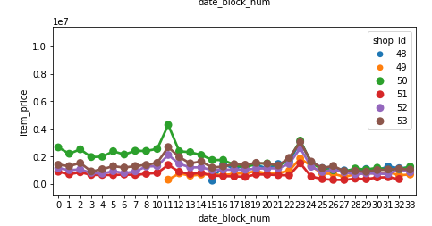
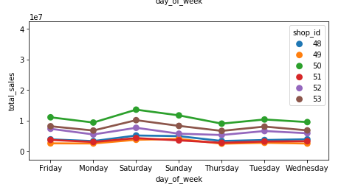
Introduction
The main objective is to predict the Total Sales of every Items/product and store for November, 2015.
Recurrent Neural Network (RNN) was used for this is timeseries forecasting.
Data preprocessed by removing from outliers, removing duplicated data and normalizing the training dataset.
Some features were extracted from data such as cities names and weekdays
Visualization was used to understand customer’s buying behavior during weekdays and different months

Slide 3
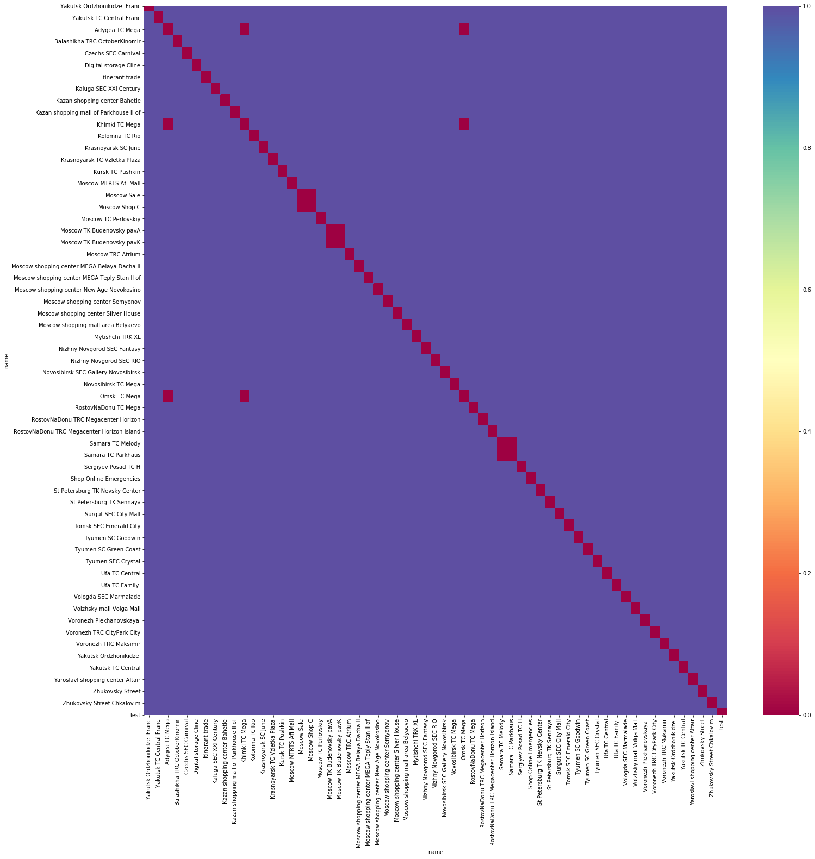
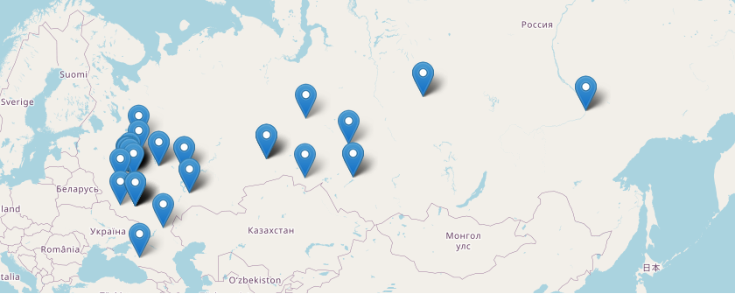
Approach: Data Visualization
From the shops names text, the cities were extracted and geospatial data found using “GepPy” . “Folium” is used to generate the map
The “levenshtein score” to generate this matrix and detect similar shops’ names

Slide 4
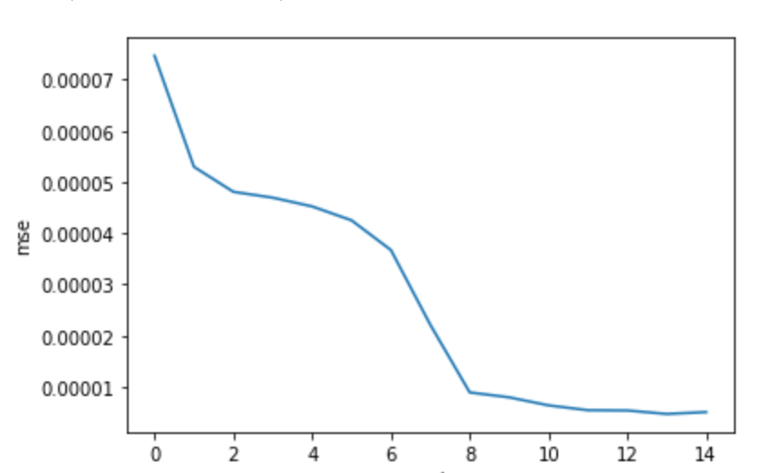
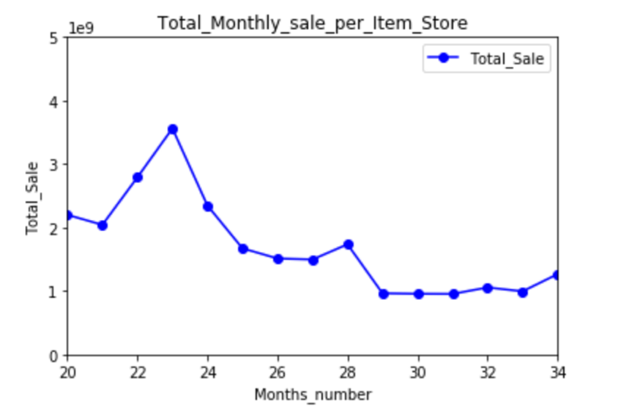
Building prediction Model
RNN models with 64 with a Dense Layer
R2 score 95.4 %
# of Epoch= 10 and dropout is 0.4

Slide 5
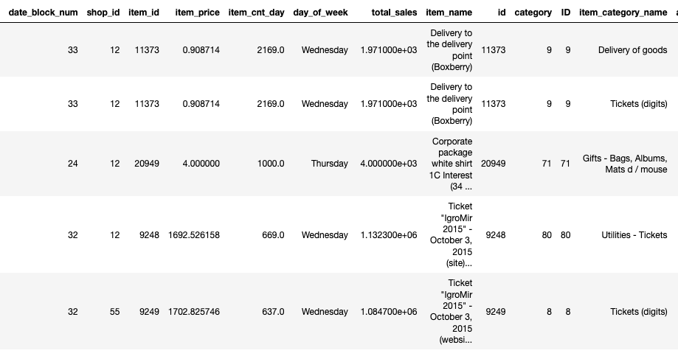
Results and Recommendations
Below Table are the top 5 selling items. It can be observed that :
1- Around 2169 item per day for Tickets and Gifts
2- Online shops ( id=12) are the main channel of selling
3- Stores can generate high return by providing online services

